Slide 1


Mobile Apps Design
Postgrado en
NOTIFICATIONS
Juan Luis Gorricho

Slide 2
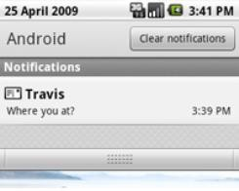
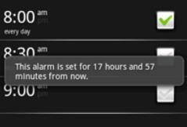
USER NOTIFICATIONS
There are situations where it’s necessary to notify the user of a new event
Three notification types are defined:
  Toast Notification
  Dialog Notification
  Status Bar Notification
2

Slide 3
NOTIFICATIONS
Toast Notification: temporal “pop-up” message, no interaction is possible, it fits the size of the content, it doesn't block the current activity visibility, it can be fired from a service even if the app. is not visible.
Dialog Notification: this is the pop-up dialog window used in previous exercises, the current activity losses the focus.
Status Bar Notification: adds an icon on the status bar. Unfolding the status bar, the icon can be shown with an associated text; clicking on that entry, Android fires an intent previously defined by the notification, usually to start an Activity.

Slide 4
STATUS BAR NOTIFICATIONS
It is recommended to use NotificationCompat.Builder to create a notification. Invoking at least: setSmallIcon(), setContentTitle(), setContentText().
To add the action to start an activity from the notification we must use a PendingIntent object. The activity is added to the stack of activities of the app. unless a specific technique is used.
To send the notification we use the NotificationManager, passing as parameters: an id and the notification itself. Different ids mean different notifications on the status bar.
The notification can be set as auto-cancelable or can be cancelled by code (individually by ID or all of them).

Slide 5
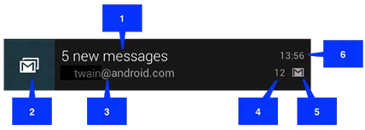
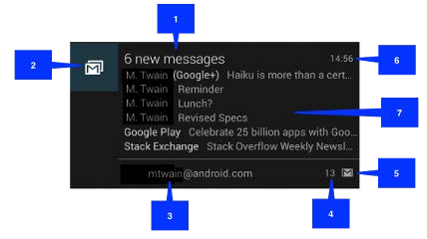
STATUS BAR NOTIFICATIONS
Two notification views are defined: normal and big. To show a big notification it has to be the first of the list or you must click on it.
Normal View:
Big View: Each big view style sets area #7 in a different way: Big picture style, Big text style or Inbox style.

